Slide 1
Machine Learning for Cyber Security Part 1
Dr Carlos Moreno Garcia
c.moreno-garcia@rgu.ac.uk
Senior Lecturer in Computing | Research Degrees Coordinator
Robert Gordon University, Aberdeen, Scotland, UK

Slide 2
1. Introduction

Slide 3
Objectives
Understand the main principles of Machine Learning (ML)
Be exposed to the most relevant tools used in academia and the industry to implement ML-based solutions
Comprehend a series of real cases where ML is used to solve cybersecurity problems

Slide 4

2005-2010: Bachelor of Electronic Engineering (Major in Telecommunications)
Tec de Monterrey, Mexico City
2010-2012: Teacher/Researcher
Research group: Centro de Investigación en Mecánica y Biodiseño (Prof. Rogelio Bustamante)
Tec de Monterrey, Mexico City
2012-2013: Ms C. Cyber Security and Intelligent Systems
Universitat Rovira i Virgili, Tarragona, Spain
2013-2016: Ph. D. Computer Science and Mathematics of Security
Research group: Sistemas Sensoriales Aplicados a la Industria (Prof. Francesc Serratosa)
Universitat Rovira i Virgili, Tarragona, Spain
2017-2018: Research Fellow in Computing
Research w/ Dr Eyad Elyan and Prof Chrisina Jayne (Industrial collaboration with DNV GL)
Robert Gordon University, Aberdeen, UK
2018: Lecturer in Computing
Placements and Electives Coordinator
Robert Gordon University, Aberdeen, UK
2020: Senior Lecturer in Computing
Research Degrees Coordinator
Robert Gordon University, Aberdeen, UK

Slide 5
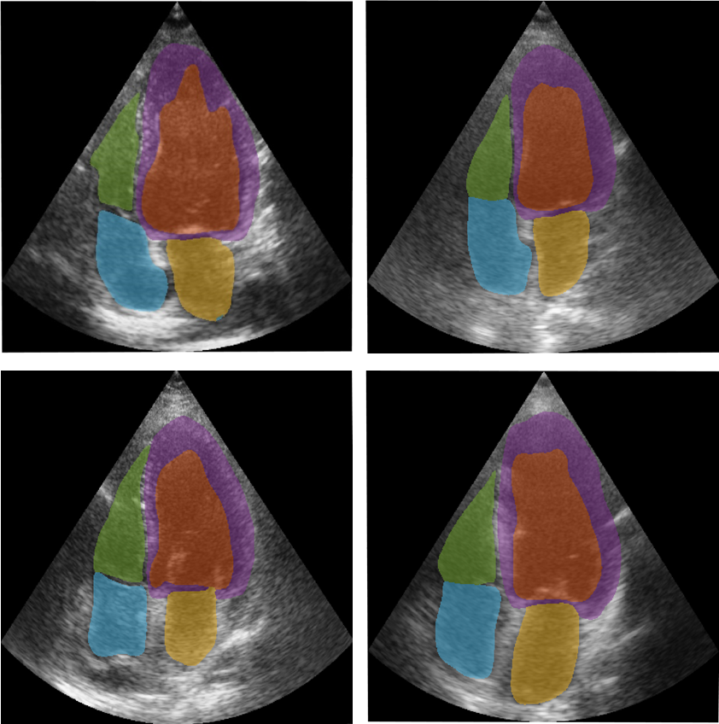
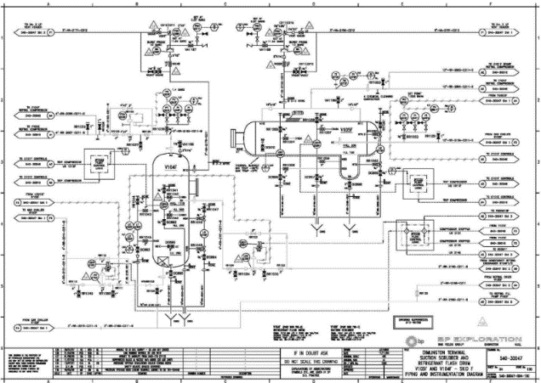






Main Achievements
Published 57 scientific papers in international journals and conferences
Two patents and several prototypes
Worked with multiple academic partners:
UNAM
IPN
Tec de Monterrey
IMP
University of Utah
University of Munster
Taylors’s University (Malaysia)
Collaboration with the industry:
Energy sector: DNV GL, Equinor (Statoil), Total, Baker, AISUS, Mintra Group, etc.
Healthcare: NHS, ISSSTE
EuDIF (RedGlobalMX and Google)
Notes:
Two patents, funding from different funding bodies, AE TNNLS, Red Global MX

Slide 6
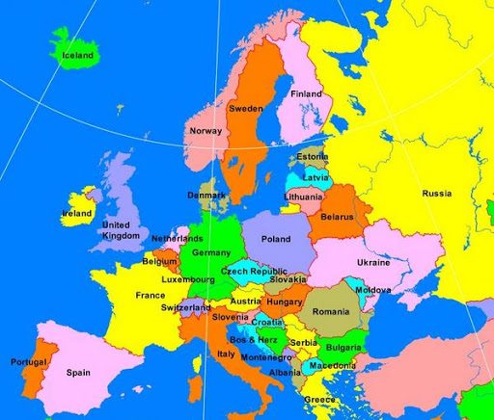
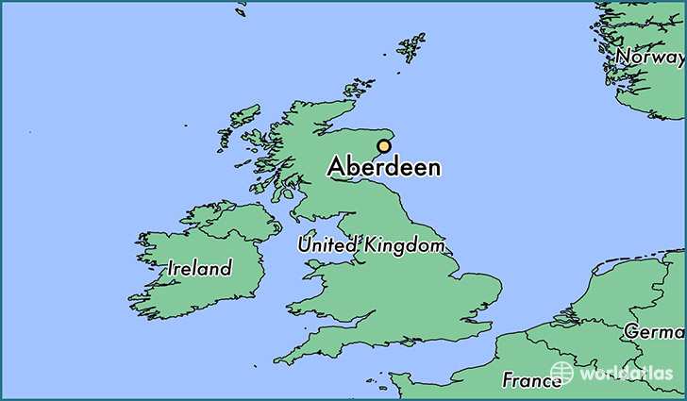
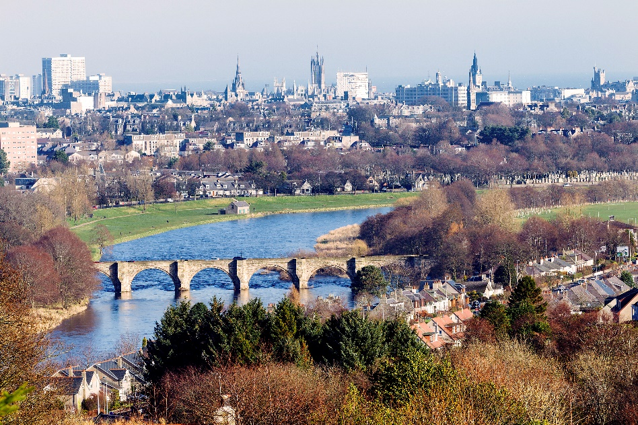
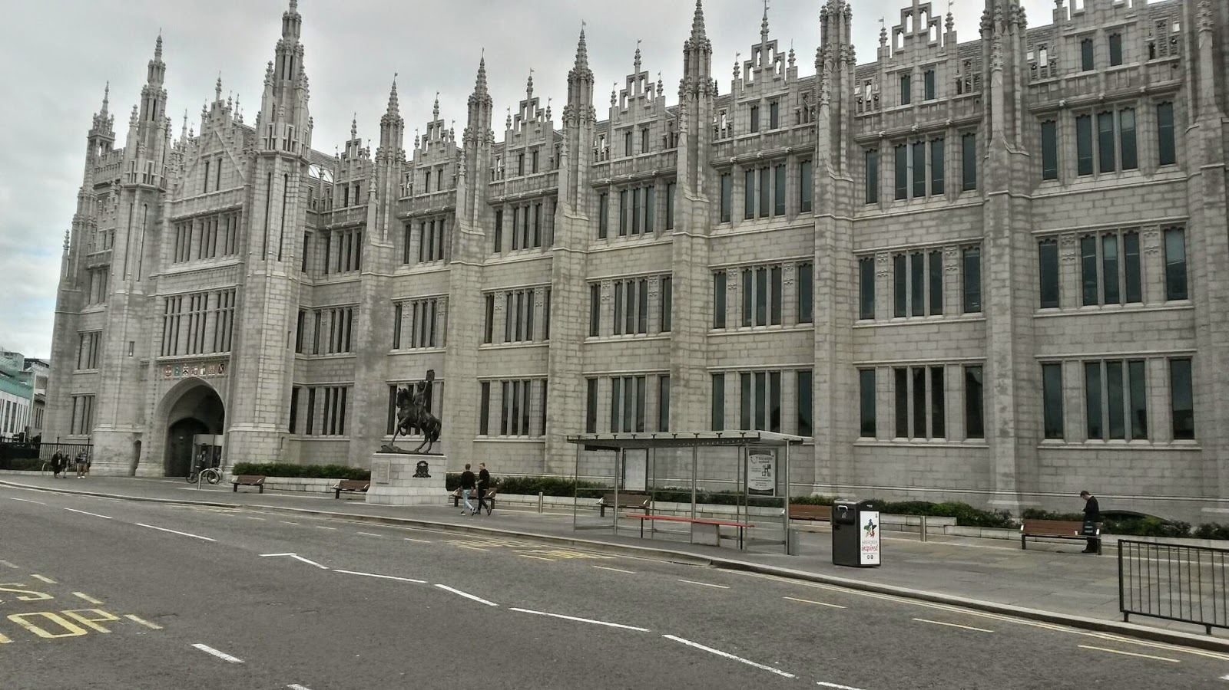
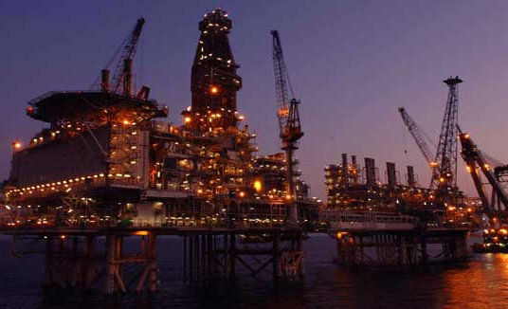
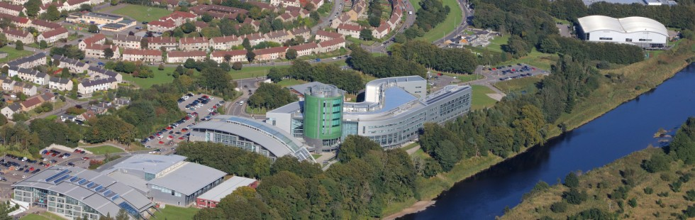
Where am I!?

Slide 7

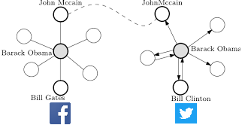
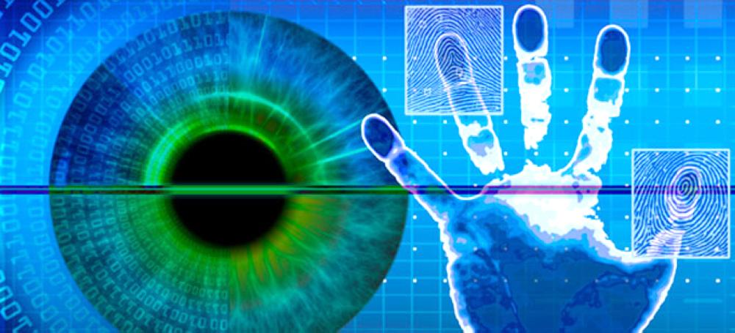
How did I get “here”?
MSc Cyber Security
Networks
Biometrics

Slide 8
2. Fundamentals of ML
Go to www.menti.com and use the code you see on the screen

Slide 9
What is ML?
“Machine learning is the scientific study of algorithms and statistical models that computer systems use to perform a specific task without using explicit instructions, relying on patterns and inference instead.” — Wikipedia
“Machine learning at its most basic is the practice of using algorithms to parse data, learn from it, and then make a determination or prediction about something in the world.” — Nvidia
“Machine learning is the science of getting computers to act without being explicitly programmed.”
— Stanford
Our working definition, it’s the statistical discrimination, where the “machine” itself learns the discriminator (mathematical models) using the provided data

Slide 10
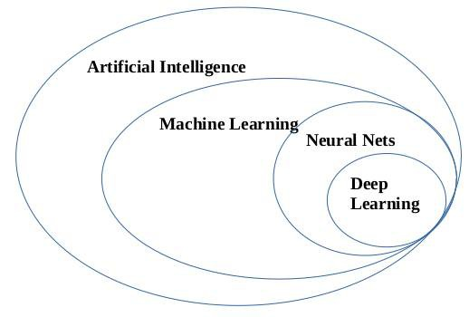
What is ML?
Artificial Intelligence: Whole knowledge field
Machine Learning: An important part of AI, but not the only one
Neural Networks: One of popular machine learning types
Deep Learning: A modern way of building, training and using NN. A new architecture

Slide 11

Why ML?
Imagine you need to buy a house
Searched all over, newly built (£400k), year-old (£380k), 2-year-old (£360), 3-year-old (£340), and so on.
Price drops by 20k every year, but no less than 100k!
Predict the price based on known historical data (regression)
But it's not that simple! Different dates, # bedrooms, present condition, location, seasonal demand spikes, etc
How many hidden factors are there to determine the house price?
An average human can't find these patterns!
Machine copes with this task much better than a human
https://www.forbes.com/sites/kashmirhill/2012/02/16/how-target-figured-out-a-teen-girl-was-pregnant-before-her-father-did/

Slide 12
How ML fits in Cyber Security?
Monitoring (user/systems) activities to search for known attacks and/or suspicious activities
Signature/misuse-based detection
Contain a database of recognised attacks
Activity is compared with signature database
Zero Day go undetected!

Slide 13
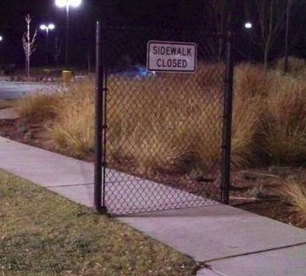
How ML fits in Cyber Security?
Anomaly/behaviour based
Use tools borrowed from Machine Learning (ML)
Assumption → behaviour differ
Have a notion of normal activity
Learnt from previously seen benign activities
High false positive rate!

Slide 14
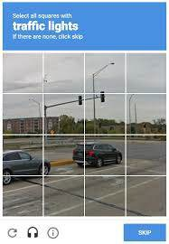
ML Components
Goal: Predict results based on incoming data:
Training data
Want forecast stocks? Find the price history
Want to detect spam? Find samples of spam/non-spams
How to gather?
Manual (accurate, expensive) and automatic (cheaper)
Google use their customers to label data
Collecting a good quality dataset is extremely difficult
Garbage in, garbage out
Companies may be happy to reveal algorithms, but not the data!
Notes:
Like bitcoin, in theory everyone knows how it works!

Slide 15
ML Components
2. Features
Individual measurable characteristic, factors for a machine to look at
Organised in a table, features are column names
Choosing right features is a crucial
Informative, discriminating and independent
Domain knowledge is essential here
3. Algorithms
Multiple algorithms for one problem (spot-check different algorithms)
The method you choose affects the precision, performance, and size of the final model
If the data is bad, even the best algorithm won't help!

Slide 16
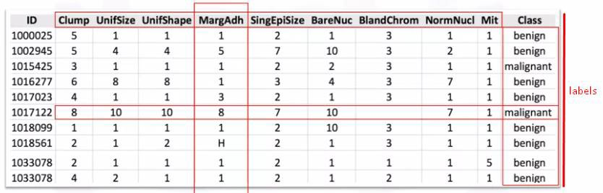
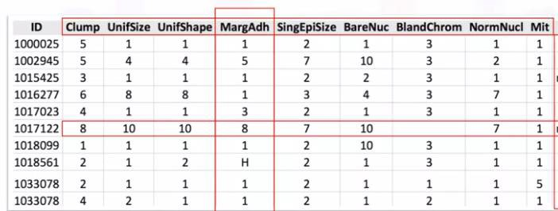
Types of Data
Structured
Easily mapped to identifiable column headers
Unstructured
Cannot be mapped
Semi-structured
A mix
Labelled
Contains tags
Unlabelled
Doesn’t

Slide 17
3.1. Tools for ML
Go to www.menti.com and use the code you see on the screen

Slide 18
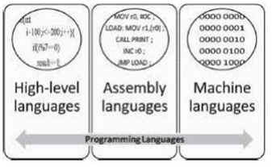
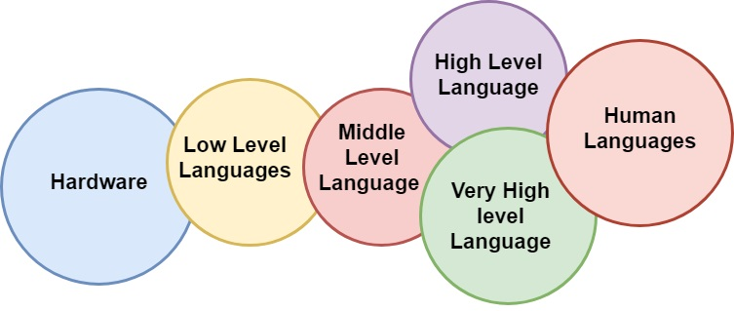
Types of Programming Languages

Slide 19
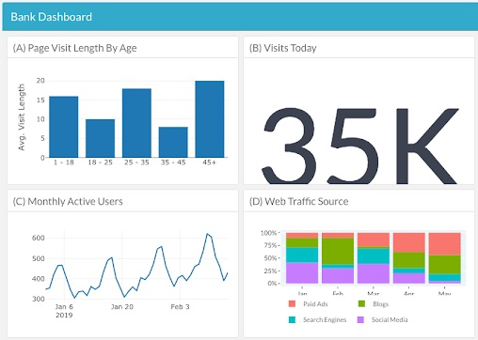
Why to Use High-Level?
Widely used
Huge growing ecosystems
Industry is on board!
Data-driven
Leads to dashboards
CONS: Speed
May be crucial in CyberSec, but there are ways to solve it

Slide 20

Why ML Top Programming Languages

Slide 21
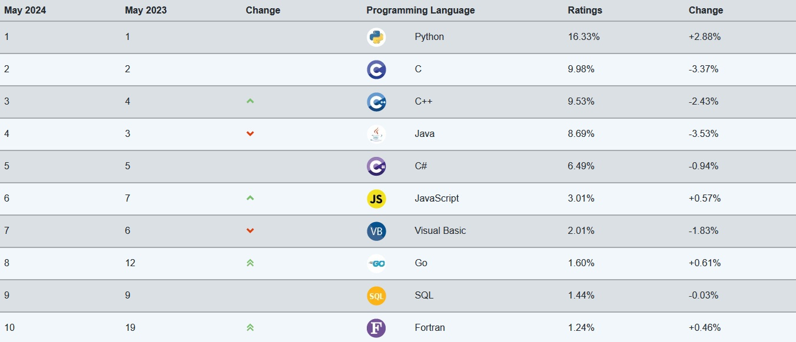
TIOBE Index
Notes:
The TIOBE Programming Community index is an indicator of the popularity of programming languages. The index is updated once a month.

Slide 22
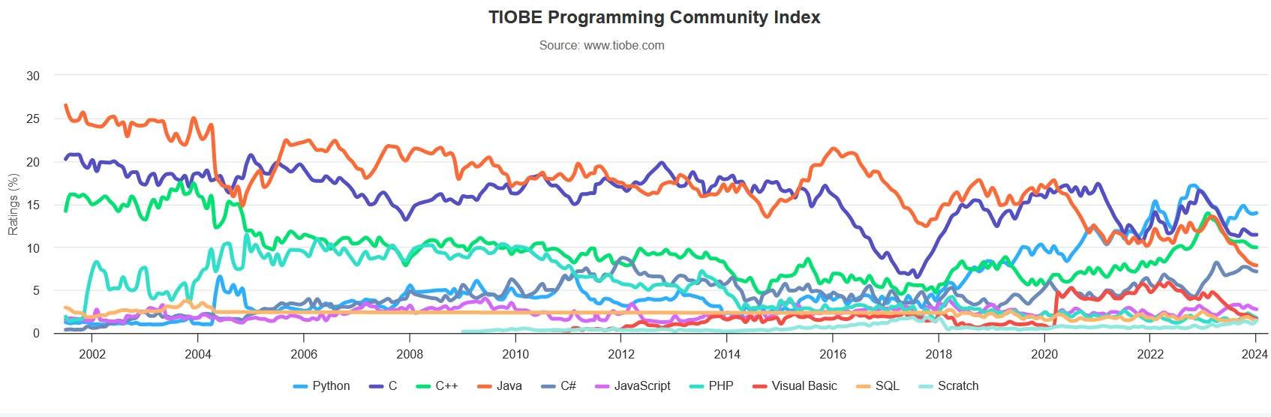
TIOBE Index
Notes:
The TIOBE Programming Community index is an indicator of the popularity of programming languages. The index is updated once a month.

Slide 23
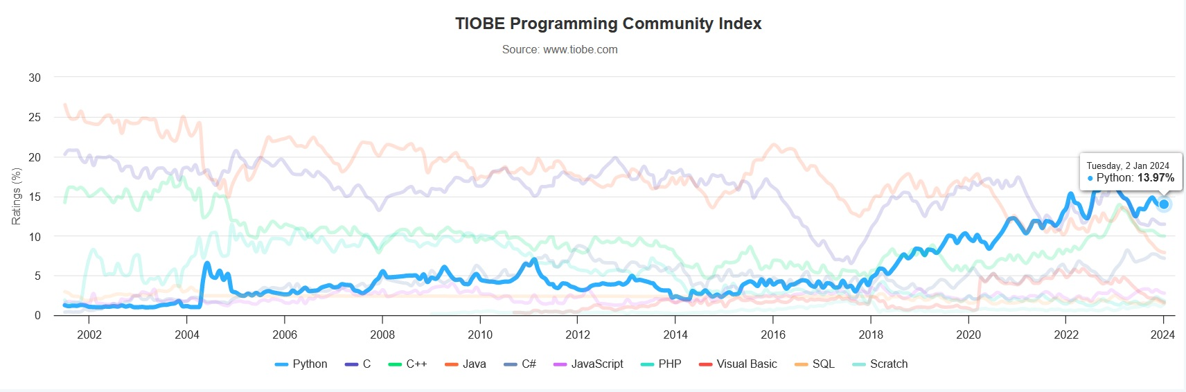
TIOBE Index
Notes:
The TIOBE Programming Community index is an indicator of the popularity of programming languages. The index is updated once a month.

Slide 24
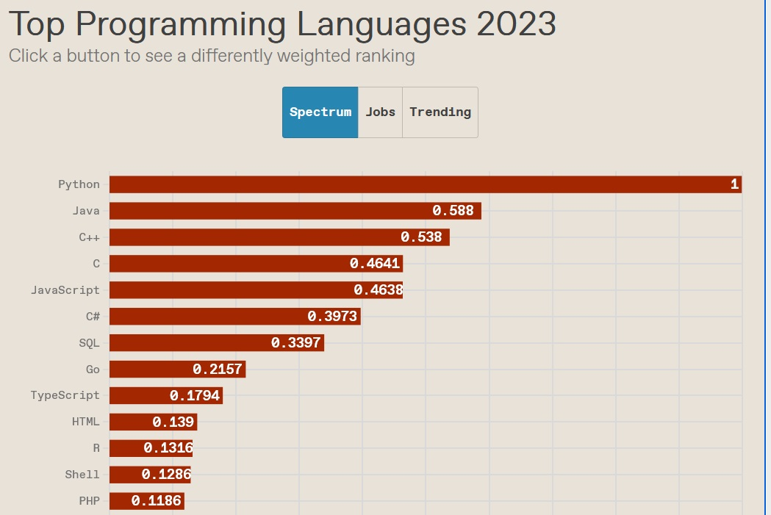
IEEE
https://spectrum.ieee.org/top-programming-languages/

Slide 25
Top paying technologies (StackOverflow Survey 2023)
https://survey.stackoverflow.co/2023/#section-top-paying-technologies-top-paying-technologies

Slide 26
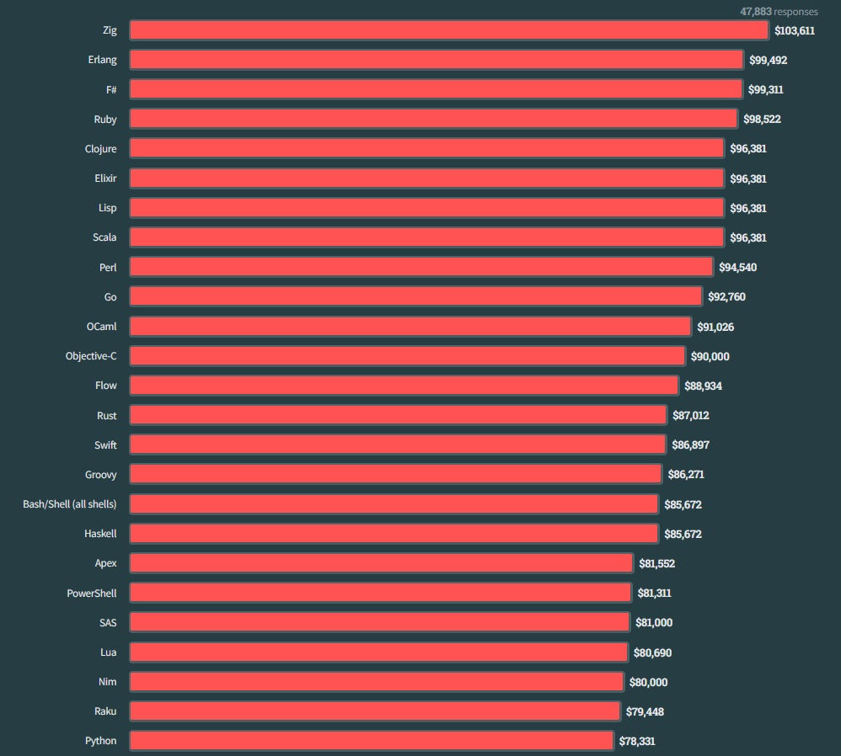
Top paying technologies (StackOverflow Survey 2023)
https://survey.stackoverflow.co/2023/#section-top-paying-technologies-top-paying-technologies

Slide 27
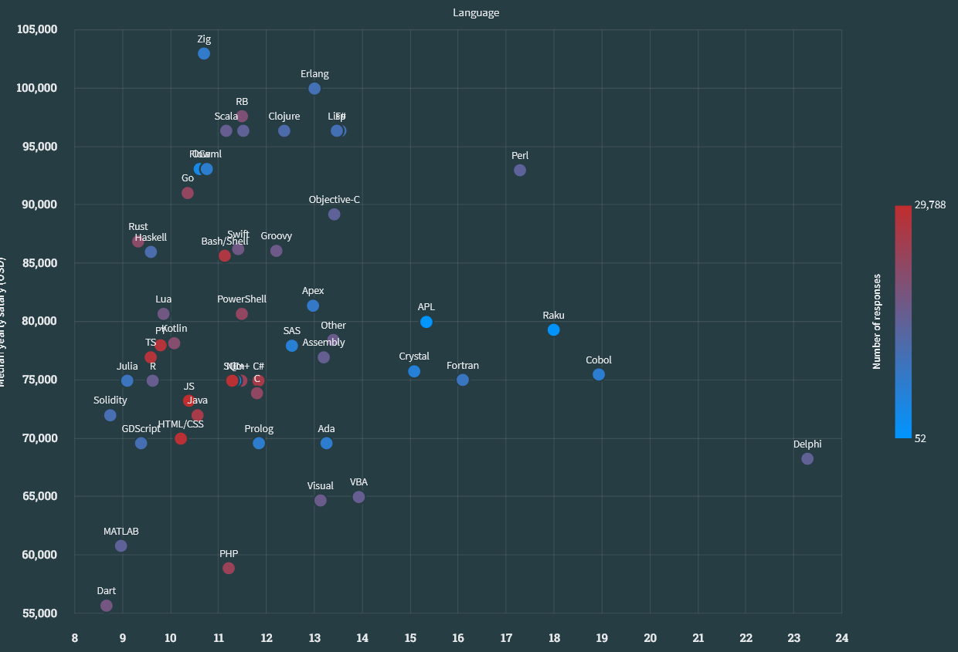
https://survey.stackoverflow.co/2023/#section-salary-salary-and-experience-by-language

Slide 28
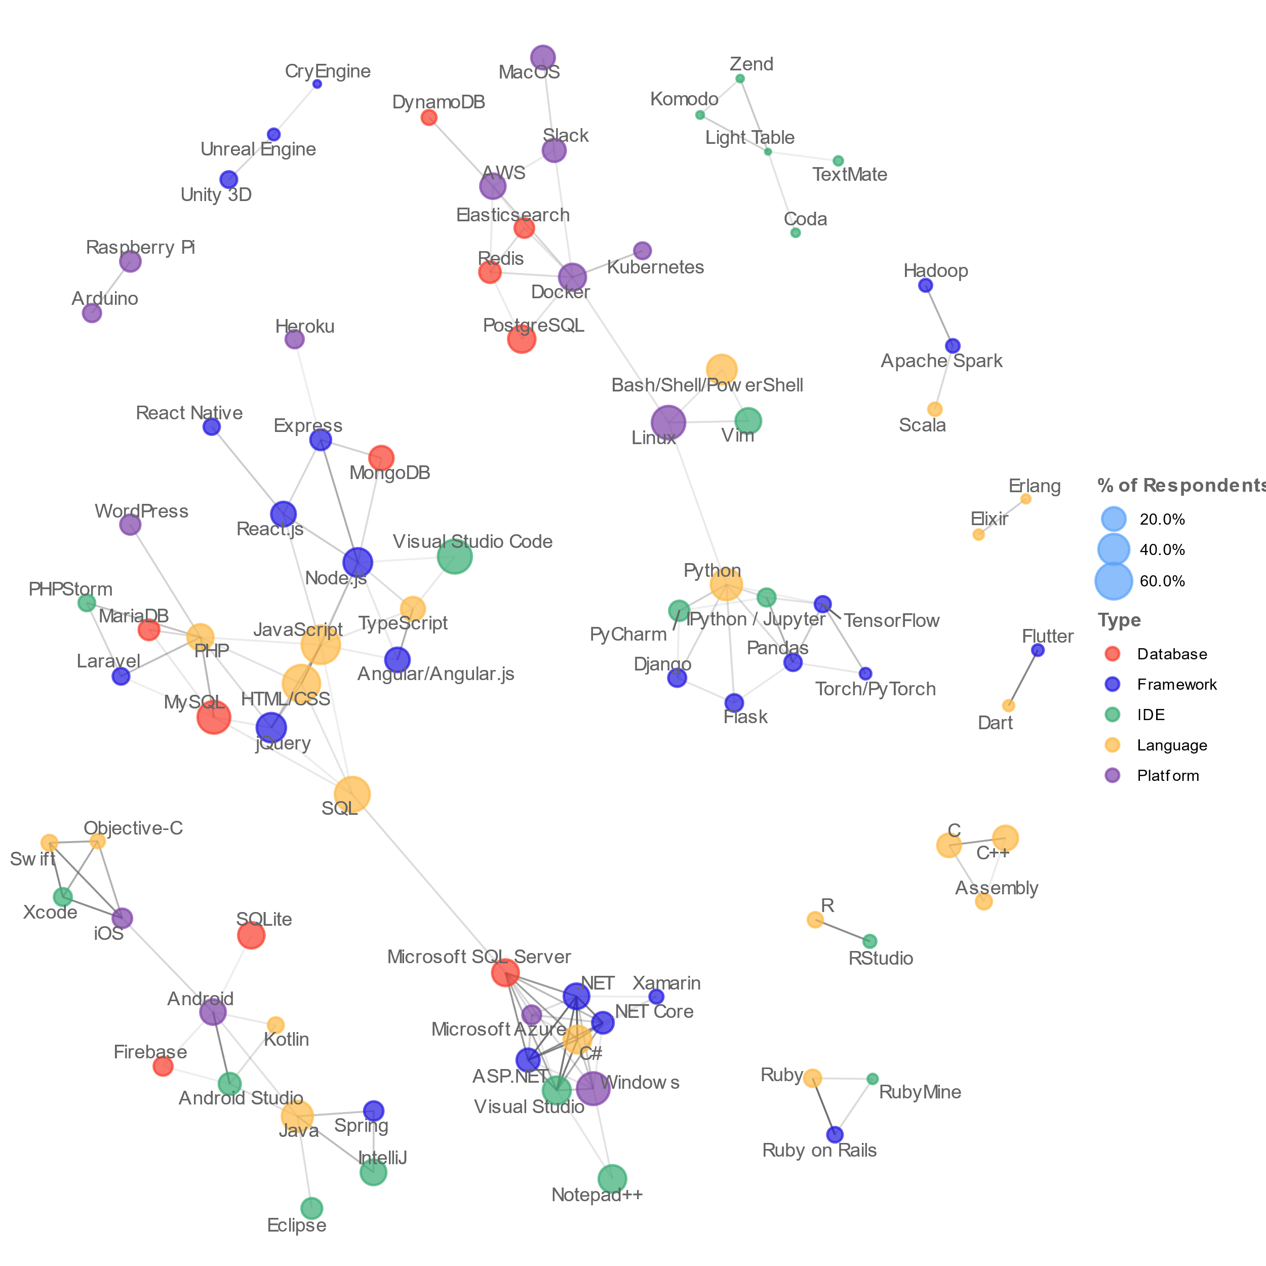
How they connect?
https://insights.stackoverflow.com/survey/2019

Slide 29
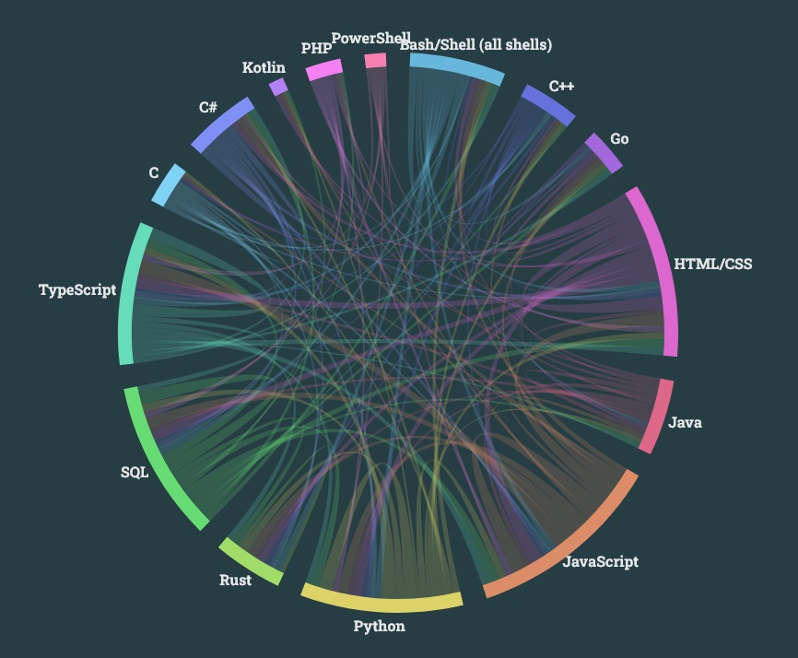
This is close!
https://survey.stackoverflow.co/2023/#section-worked-with-vs-want-to-work-with-integrated-development-environment

Slide 30
What are R and Python?
Open-source programming language for statistical analysis, graphics, data science and machine learning.
Command-line based, however, complementary tools provide a friendly user interface(s).
Will require you to learn both syntax and semantics.

Slide 31


What do we use them for?
Exploratory and statistical data analysis.
Visualisation and graphics.
Data preparation (data wrangling).
Machine learning and modelling.

Slide 32



Why these tools?
Free.
Easy to use.
Have packages for everything.
Have great online support community.
Statistics tools AND programming languages.
Available across platforms.
Similar to MATLAB.
Robust for visualisations.
You can produce reports of your work easily.

Slide 33
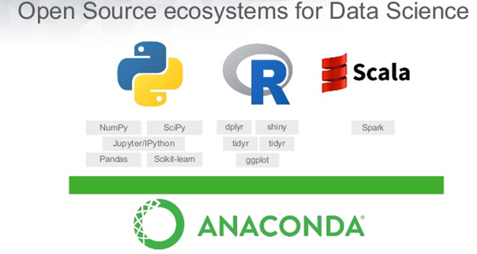
How to Install?
OR Download Anaconda!
https://www.anaconda.com/
Download R
http://cran.r-project.org/
Download RStudio (IDE)
http://www.rstudio.com
3. Download Python
https://www.python.org/downloads/
4. Download an IDE
https://www.spyder-ide.org/
https://www.jetbrains.com/pycharm/
https://jupyter.org/

Slide 34
Where to Learn?
Coursera
https://www.coursera.org/
DataCamp
https://www.datacamp.com/
RGU offers online short courses!
https://www.rgu.ac.uk/study/courses/3274-introduction-to-data-science-with-python-15-credits-at-scqf-level-9
https://www.rgu.ac.uk/study/courses/5630-computer-vision-for-the-energy-sector

Slide 35
3.2. Demo of Python and R
R in RStudio
Python in
Console
Spyder
PyCharm
Jupyter Notebook
Rise Slides

Slide 36
3.3. Demo of Online Notebook Platforms
Google Colab (mostly for Python)
Kaggle (both, plus a great data source)
GitHub (Code repository)
HuggingFace

Slide 37
4.1 Types of ML

Slide 38
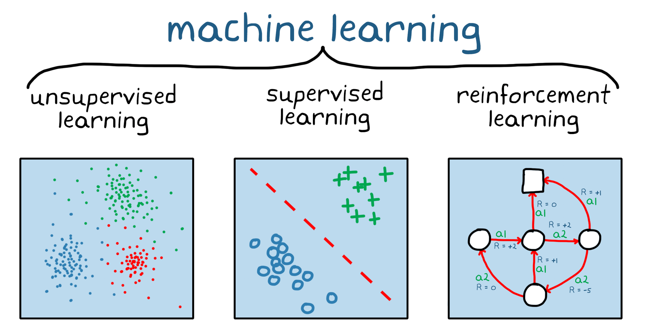

(Main) Types
Supervised
Learn from labelled data, used to classify or predict
e.g. object recognition systems, spam detectors
Unsupervised
Initial data is not labelled, insights are drawn by processing data (structure is unknown in advance), clustering, association, anomaly detection.
e.g. user behaviour analysis, market basket analysis
Reinforcement
No supervisor, only a reward signal is used for an agent to determine if they are doing well or not
Type of dynamic programming, system learns from its environment, maximises the gain
Reward, no training data involved, learns on the go via trial and errors (rewards and punishments)
e.g. self driving cars to navigate through the traffic https://www.youtube.com/watch?v=W2CAghUiofY&feature=emb_logo

Slide 39
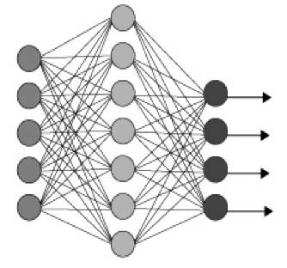
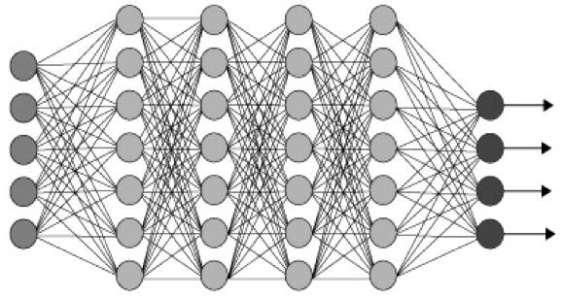
(More) Types
Semi-Supervised
Initial training data is incomplete, both labelled and unlabelled data are used in the training
Deep
Neural networks (NN) with number of hidden layers Back-propagation to train deep neural nets
Active
User constantly feeds algorithm with labels
Used for NLP tasks (systematic reviewing)
Imitation
Used mostly in robotics
Input
Output
Shallow NN
Input
Output
Deep NN

Slide 40
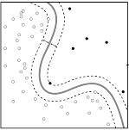
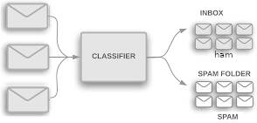
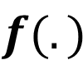
Solving a problem using ML logic
spam
Feature 2
$$f(.)$$
ham
Feature 1
Notes:
If we have many features, the problem may not be linear anymore!

Slide 41
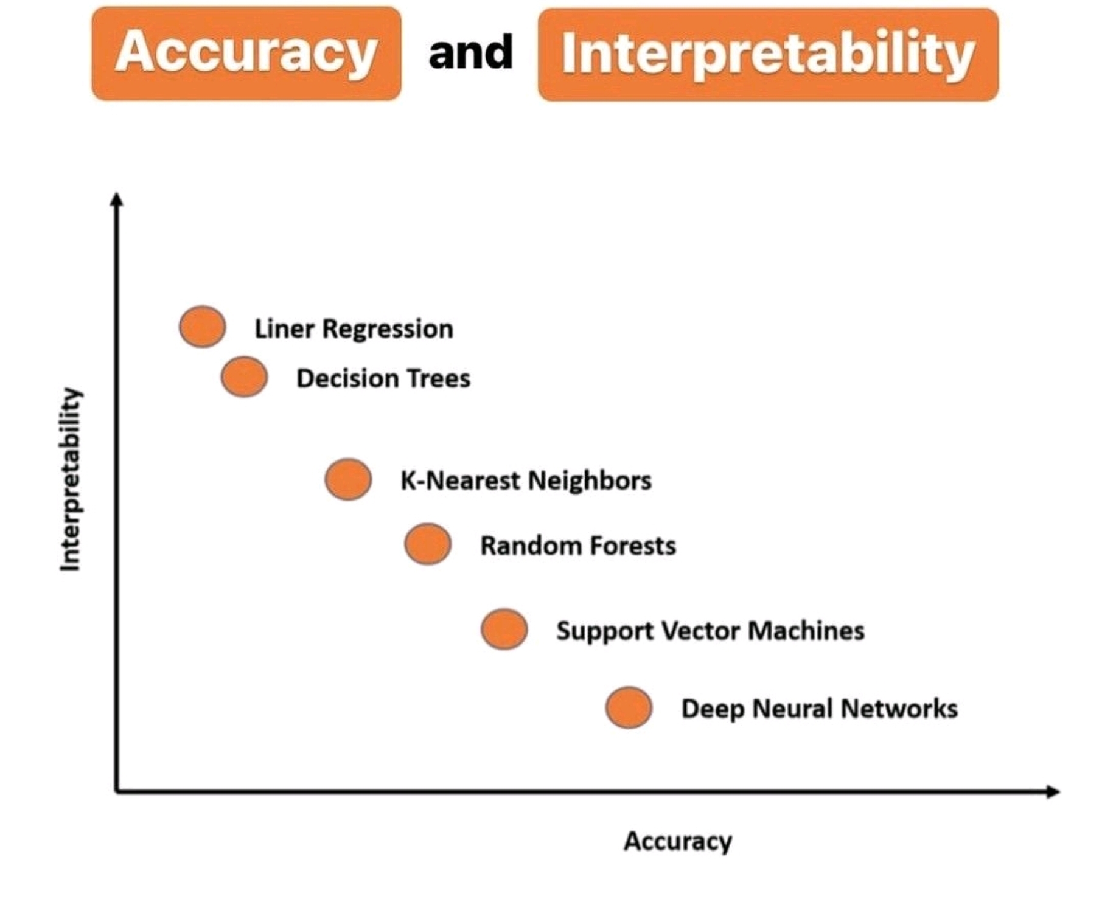

Slide 42
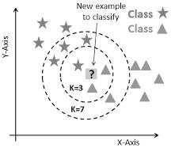
K Nearest Neighbours (KNN)
% R CODE
library(caret)
fit.knn <- train(Species~.,
data=dataset, method="knn")
predicted= predict(fit.knn,x_test)
Classified by a majority vote of neighbours
K is an integer specified by human
Non-parametric algorithm - not making any assumption on data distribution
Lazy algorithm - does not really learn any model and make generalisation of the data
Advantages: Simple to implement, robust to noisy training data, and effective if training data is large
Disadvantages: Need to determine the value of K computation cost is high

Slide 43
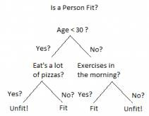
Decision Tree/Random Forest
library(caret)
fit.dt <- train(Species~.,
data=dataset, method="rpart")
predicted= predict(fit.dt,x_test)
Segment the predictor space into multiple regions
Each region has only a subset of the training dataset
High variance → Small changes in the training data can give an entirely different decision tree model
Led to better classifiers → Random Forest

Slide 44
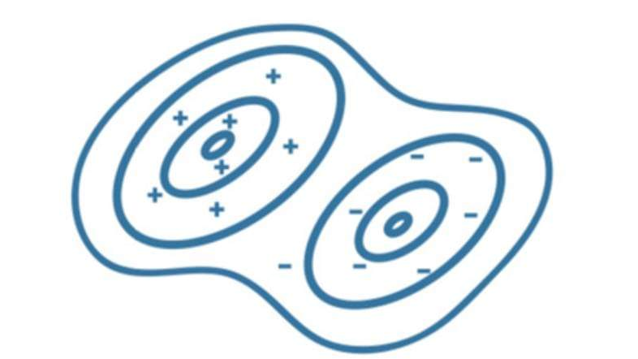
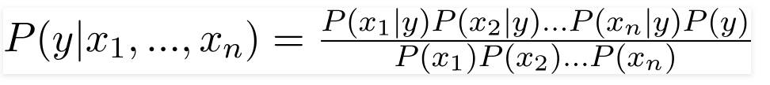
Naïve Bayes (NB)
x <- cbind(x_train,y_train)
fit <-naiveBayes(y_train ~ ., data = x) predicted= predict(fit,x_test)
Probabilistic classifier inspired by the Bayes theorem
Assumes attributes are conditionally independent
Advantages: small amount of training data required, extremely fast (on training)
Disadvantages: zero probability problem, if the conditional probability is zero for a particular attribute...
“Hard” to understand, simple to implement
Posterior
Attributes likelihoods
Predictor prior
Class prior

Slide 45
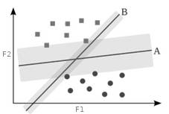
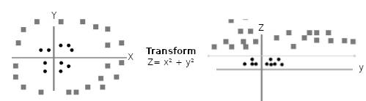
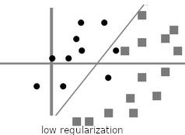
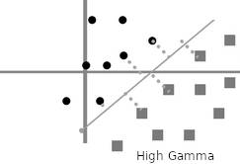
Support Vector Machine
x <- cbind(x_train,y_train)
fit <-svm(y_train ~ ., data = x) predicted= predict(fit,x_test)
Discriminative classifier defined by a separating hyperplane
Tuning parameters in SVM classifier
Kernel - transformation method, e.g. Polynomial and exponential kernels
Regularization - how much to avoid misclassifying each training example
Gamma - how far the influence of a single training example reaches, high gamma → only nearby examples
A margin in SVM is a separation of line to the closest class points
Good margin is one where this separation is larger for both the classes
Kernel method

Slide 46
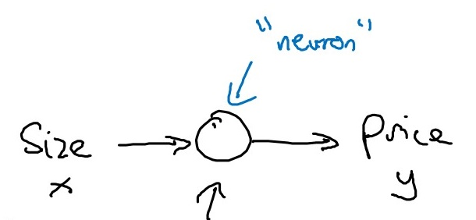
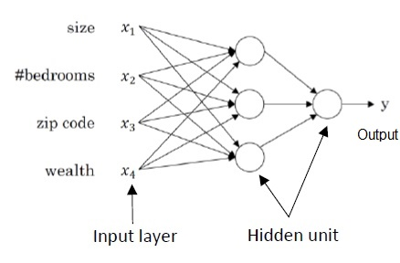
Neural Network (NN)
Each “neuron” is trained to be activated/deactivated given certain weights and biases
Multiple neurons work together to solve a multi-variable problem
If more layers are added to the NN model, second-order relations can be discovered
There are “easy models” that can be implemented in three lines of code, but if you want to do it properly, you need to be more skilled!

Slide 47
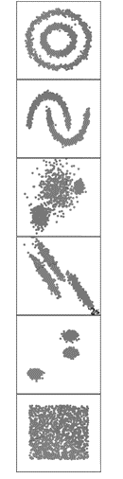
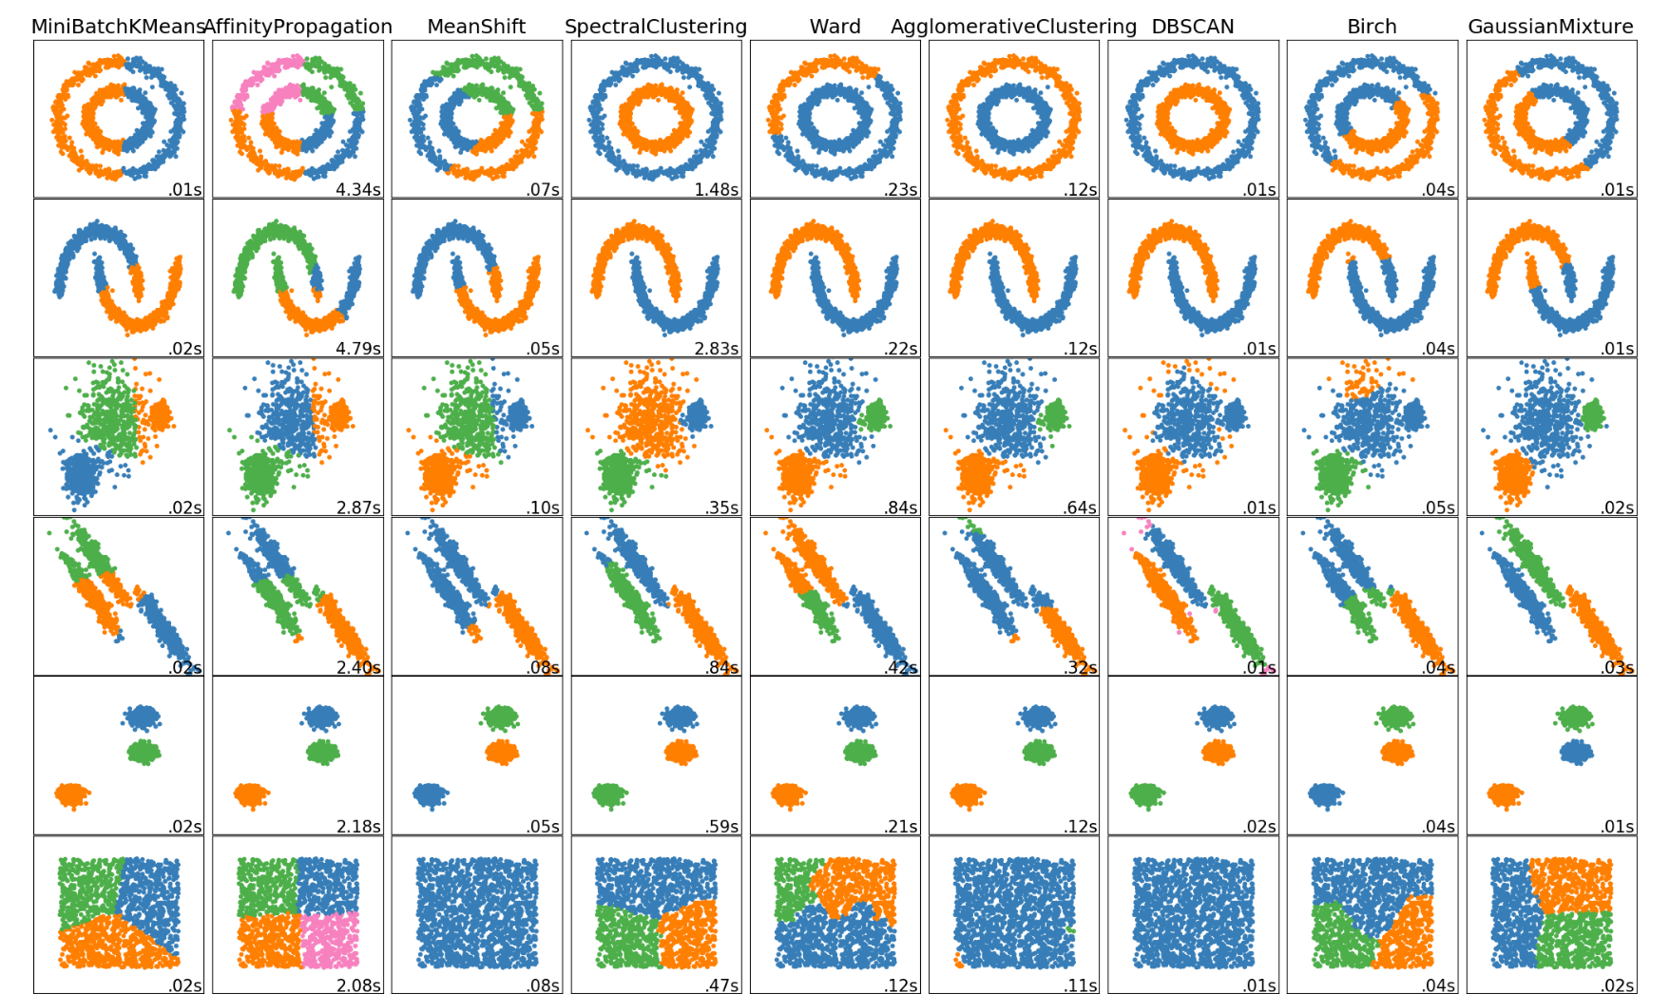
Clustering (unsupervised) with K Means
Not to be confused with KNN!
Two main steps:
Cluster assignment
Centroid recalculation

Slide 48
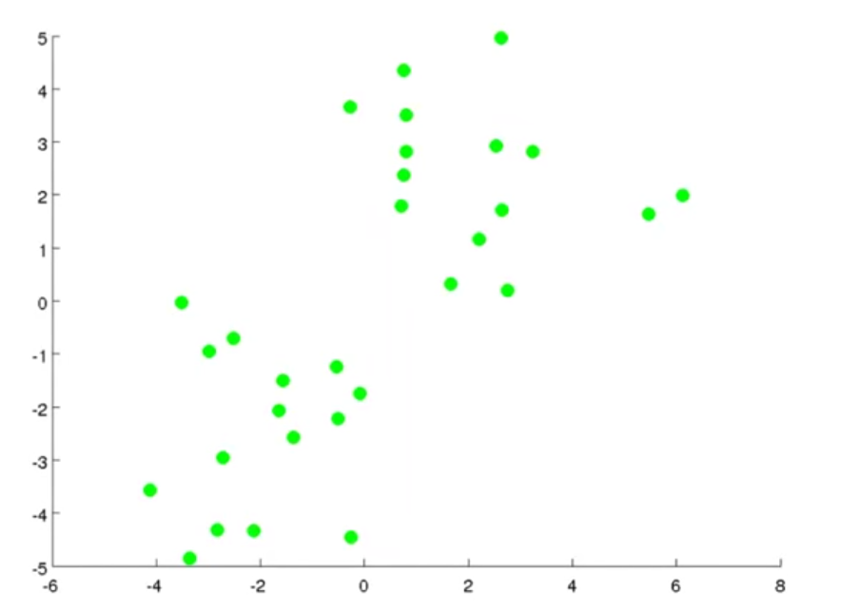


Example
https://www.youtube.com/watch?v=Ao2vnhelKhI

Slide 49
1. Select the number of clusters & randomly initialise k centroids.
k=2
https://www.youtube.com/watch?v=Ao2vnhelKhI

Slide 50
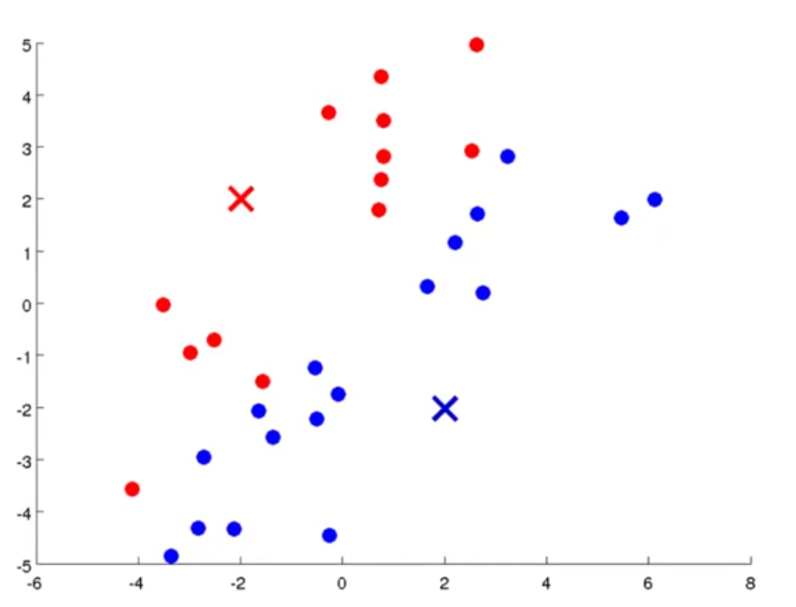
2. Assign each data point to a cluster (red or blue) according to the minimum distance to a centroid.
https://www.youtube.com/watch?v=Ao2vnhelKhI

Slide 51
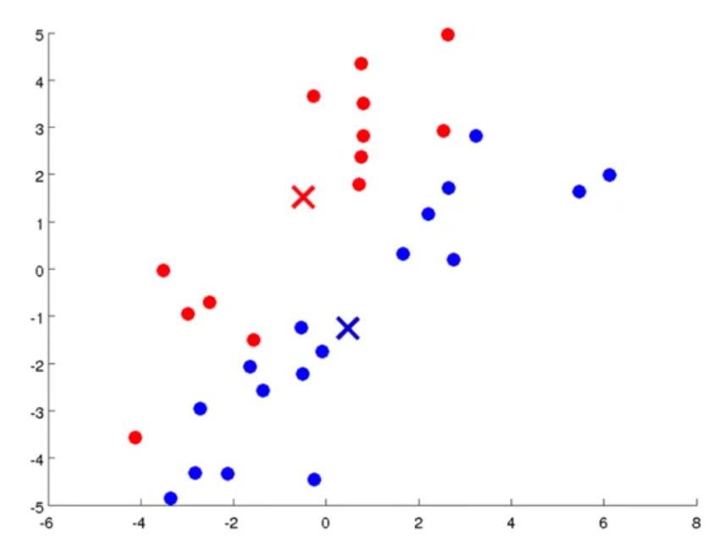
3. Compute the mean of each cluster and move the centroid to that position.
https://www.youtube.com/watch?v=Ao2vnhelKhI

Slide 52
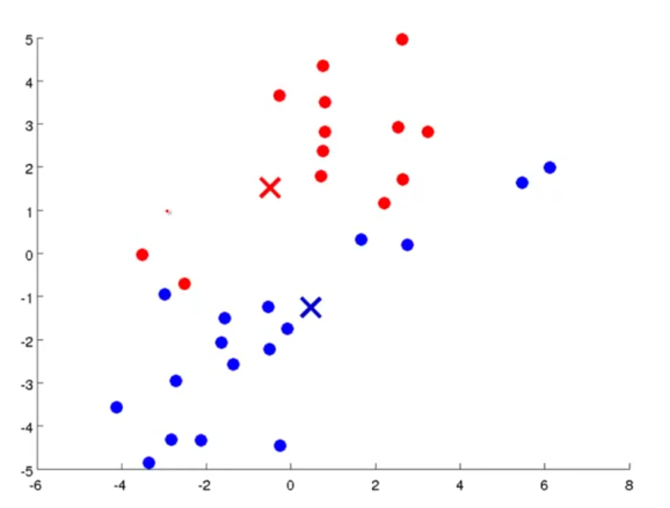
4. Compute a new set of clusters based on the new centroids.
https://www.youtube.com/watch?v=Ao2vnhelKhI

Slide 53

5. Iterate until clusters don’t change (convergence).
https://www.youtube.com/watch?v=Ao2vnhelKhI

Slide 54
4.2 Practical Example (Iris)
Link to online Jupyter Notebook: https://colab.research.google.com/drive/1gDVOrqs3d3Ycb7X2wY7XC9oCMsKzb0j7?usp=sharing

Slide 55
5. Evaluating ML

Slide 56

Evaluating ML
Now that we know how to implement (basic) ML algorithms, we need to assess their effectiveness
Accuracy is not the only way!
There are numerous metrics that help us understand how well our algorithms are performing
Notes:
Hablar de CroosVal y LOO

Slide 57






Over/Under Fitting
Assume we want to fit a regression to a series of observations:
$$f(.)$$
$$f(.)$$
$$f(.)$$
Underfitting
Overfitting
Good fit
Notes:
Common machine learning procedures help to overcome these issues: Cross validation, data pruning, regularisation/generalisation, etc

Slide 58
Assuming a binary scenario
True Positives (TP)
This is what many people think accuracy is (but it’s not!)
Samples from the positive class that are classified correctly
True Negatives (TN)
How many samples from the negative class are NOT classified as being from the positive one
False Positives (FP)
How many samples from the negative class are classified as being from the positive class
Also known in statistics as False Alarms or Type I Error
False Negatives (FN)
How many samples from the positive class are classified as being from the negative class
Also known in statistics as Type II Error

Slide 59

So what is the accuracy?
Value between 0 and 1
Not a suitable metric for imbalanced scenarios
Why?
$$Accuracy= \frac{TP+TN}{TP+TN+FP+FN}$$

Slide 60

Precision and Recall
These metrics focus on the balance between the relevant and irrelevant elements
Consider if the positive case is easy to find

Slide 61


Precision
$$Precision= \frac{TP}{TP+FP}$$
How much of what I have I need?

Slide 62


Recall
$$Recall= \frac{TP}{TP+FN}$$
How much of what I need I have?

Slide 63

F1-score
Harmonic mean between precision and recall
Helps gauge both
There are different interpretations and variations
$$F1=2× \frac{Precision ×Recall}{Precision+Recall}=\frac{2×TP}{\left(2×TP\right)+FP+FN}$$

Slide 64

Confusion Matrix

Slide 65

Confusion Matrix

Slide 66
Multiclass
There are many ways to adapt the aforementioned metrics to these scenarios, the most common one being the One vs All approach
Comparing a metric of one class against the rest as if these were a single class
Considering that you can still calculate precision, recall and F1-score for each class (against the rest), another commonly used approach is macro/weighted/micro metrics:
Macro: Arithmetic mean
Weighted: multiply each by number of sample
Micro: Harmonic mean → accuracy

Slide 67
6. Final Considerations

Slide 68




Final Considerations
Runtime
Not very academic, but HUGELY important in practice!
How “green” is my algorithm?
https://medium.com/codex/what-are-the-greenest-programming-languages-e738774b1957
How “ethical” is my algorithm
Data privacy
Jobs that it will take/create?
Check that our algorithms are NOT racist!
https://sitn.hms.harvard.edu/flash/2020/racial-discrimination-in-face-recognition-technology/
End of days!
ChatGPT
Dall-E

Slide 69
“Homework”
Review the classical concepts of programming
Data structures (string, int, Boolean, etc)
Conditional (if/else, while, for)
Creating functions
Get familiar with Python and/or R
Do a course according to your level
Practice!
https://www.w3schools.com/python/python_exercises.asp
https://projecteuler.net/

